Slide 1
Overview of 3G

Slide 2

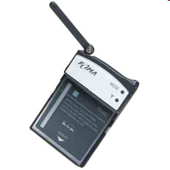
Why 3G?
Higher bandwidth enables a range of new applications!!
For the consumer
  Video streaming, TV broadcast
  Video calls, video clips – news, music, sports
  Enhanced gaming, chat, location services…
For business
  High speed teleworking / VPN access
  Sales force automation
  Video conferencing
  Real-time financial information

Slide 3
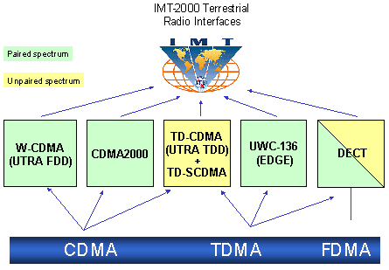
3G Standards
3G Standard is created by ITU-T and is called as IMT-2000.
The aim of IMT-2000 is to harmonize worldwide 3G systems to provide Global Roaming.

Slide 4
Upgrade paths for 2G Technologies
2G
IS-95
GSM-
IS-136 & PDC
GPRS
2.5G
IS-95B
HSCSD
EDGE
Cdma2000-1xRTT
W-CDMA
3G
Cdma2000-1xEV,DV,DO
EDGE
TD-SCDMA
Cdma2000-3xRTT
3GPP2
3GPP

Slide 5

Evolution of Mobile Systems to 3G
- drivers are capacity, data speeds, lower cost of delivery for revenue growth
Expected market share
TDMA
90%
EDGE
EDGE
Evolution
GSM
GPRS
3GPP Core
Network
WCDMA
HSDPA
PDC
CDMA2000
1x EV/DV
cdmaOne
10%
CDMA2000
1x
CDMA2000
1x EV/DO
2G
First Step into 3G
3G phase 1
Evolved 3G

Slide 6
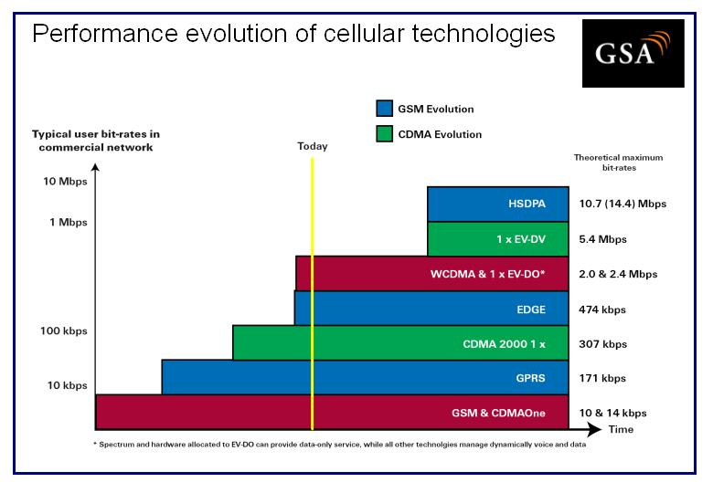
Performance evolution of cellular technologies

Slide 7
Services roadmap
Improved performance, decreasing cost of delivery
3G-specific services take advantage of higher bandwidth and/or real-time QoS
Broadband
in wide area
Video sharing
Video telephony
Real-time IP
multimedia and games
Multicasting
A number of mobile services are bearer independent in nature
Multitasking
WEB browsing
Corporate data access
Streaming audio/video
MMS picture / video
xHTML browsing
Application downloading
E-mail
Voice & SMS
Presence/location
Push-to-talk
Typical average bit rates
(peak rates higher)
GSM
9.6
kbps
GPRS
171
kbps
EGPRS
473
kbps
WCDMA
2
Mbps
HSDPA
1-10
Mbps
CDMA
2000 1x
CDMA
2000-EVDO
CDMA
2000-EVDV

Slide 8
2G TECHNOLOGIES
 | CdmaOne, IS-95 | GSM, DCS-1900 | IS-54/IS-136, PDC
Uplink Frequencies | 824-849 MHz (US Cellular) 1850-1910 MHz (US PCS) | 890-915 MHz (Europe) 1850-1910 MHz (US PCS) | 800 MHz, 1500 MHz (Japan) 1850-1910 MHz (US PCS)
Downlink Frequencies | 869-894 MHz (US Cellular) 1930-1990 MHz (US PCS) | 935-960 MHz (Europe) 1930-1990 MHz (US PCS) | 824-849 MHz (US Cellular) 1930-1990 MHz (US PCS) 800 MHz, 1500 MHz (Japan)
Duplexing | FDD | FDD | FDD
Multiple Access Tech. | CDMA | TDMA | TDMA
Modulation | BPSK with Quadrature Spreading | GMSK with BT=0.3 | π/4 DQPSK
Carrier Separation | 1.25 MHz | 200 KHz | 30 KHz (IS-136) (25 KHz for PDC)
Channel Data Rate | 1.2288 Mchips/sec | 260.833 Kbps | 48.6 Kbps (IS-136) (25 KHz for PDC)
Voice Channels per carrier | 64 | 8 | 3
Speech Coding | CELP @ 13 Kbps, EVRC @ 8 Kbps | RPE-LTP @ 13 Kbps | VSELP @ 7.95 Kbps

Slide 9
GSM evolution to 3G
High Speed Circuit Switched Data
Dedicate up to 4 timeslots for data connection ~ 50 kbps
Good for real-time applications c.w. GPRS
Inefficient -> ties up resources, even when nothing sent
Not as popular as GPRS (many skipping HSCSD)
Enhanced Data Rates for Global Evolution
Uses 8PSK modulation
3x improvement in data rate on short distances
Can fall back to GMSK for greater distances
Combine with GPRS (EGPRS) ~ 384 kbps
Can also be combined with HSCSD
GSM
9.6kbps (one timeslot)
GSM Data
Also called CSD
HSCSD
GSM
GPRS
WCDMA
General Packet Radio Services
Data rates up to ~ 115 kbps
Max: 8 timeslots used as any one time
Packet switched; resources not tied up all the time
Contention based. Efficient, but variable delays
GSM / GPRS core network re-used by WCDMA (3G)
EDGE

Slide 10
GPRS
General Packet Radio Service
  Packet based Data Network
  Well suited for non-real time internet usage including retrieval of email, faxes and asymmetric web browsing.
  Supports multi user network sharing of individual radio channels and time slots.
  Provides packet network on dedicated GSM radio channels
  GPRS overlays a packet-switched architecture on existing GSM network architecture
Variable performance…
  Packet Random Access, Packet Switched
  Content handling
  Throughput depends on coding scheme, # timeslots etc
  From ~ 9 kbps min to max. of 171.8 kbps (in theory!)

Slide 11
GPRS (contd..)
Modulation – GMSK
Symbol Rate – 270 ksym/s
Modulation bit rate – 270 kbps
Radio data rate per time slot – 22.8kbps
User data rate per time slot – 20kbps (CS4)
User data rate (8 time slots) – 160kbps, 182.4kbps
Applications are required to provide their own error correction scheme as part of carried data payload.

Slide 12
Channel data rates determined by Coding Scheme
Use higher coding schemes (less coding, more payload) when radio conditions are good
20
CS 4
16
CS 3
12
Max throughput per GPRS channel
(netto bitrate, kbit/sec)
CS 2
8
CS 1
4
0
27dB
23dB
19dB
15dB
11dB
7dB
3dB
C/I
CS1 guarantees connectivity under all conditions (signaling and start of data)
CS2 enhances the capacity and may be utilised during the data transfer phase
CS3/CS4 will bring the highest speed but only under good conditions

Slide 13
EDGE
EDGE Enhanced Data Rates for Global Evolution
  EDGE is add-on to GPRS
  Uses 8-PSK modulation in good conditions
  Increase throughput by 3x (8-PSK – 3 bits/symbol vs GMSK 1 bit/symbol)
  Offer data rates of 384kbps, theoretically up to 473.6kbps
  Uses 9 Modulation coding schemes (MCS1-9)
  MCS(1-4) uses GMSK, while MCS(5-9) uses 8PSK modulation.
  Uses Link adaptation algorithm
  Modulation Bit rate – 810kbps
  Radio data rate per time slot – 69.2kbps
  User data rate per time slot – 59.2kbps (MCS9)
  User data rate (8 time slots) – 473.6kbps
New handsets / terminal equipment; additional hardware in the BTS, Core network and the rest remains the same
EDGE access develops to connect to 3G core

Slide 14
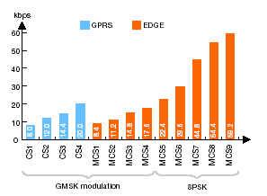
Coding Schemes for EGPRS

Slide 15
UMTS
UMTS is the European vision of 3G.
UMTS is an upgrade from GSM via GPRS or EDGE.
The standardization work for UMTS is carried out by Third Generation Partnership Project (3GPP).
Data rates of UMTS are:
  144 kbps for rural
  384 kbps for urban outdoor
  2048 kbps for indoor and low range outdoor
Virtual Home Environment (VHE)

Slide 16
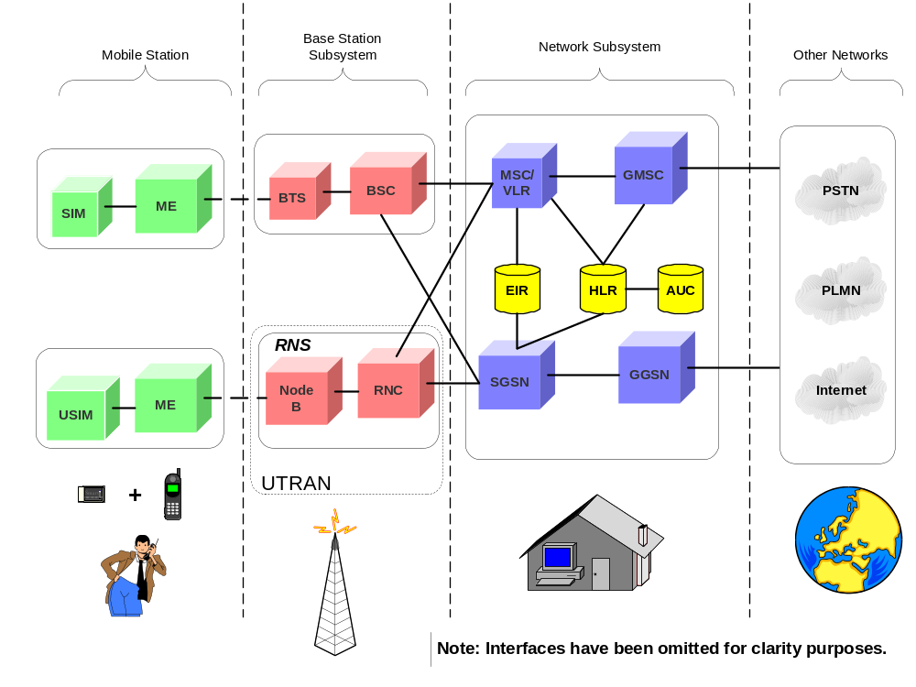
UMTS Network Architecture
Notes:
Replacing the existing GSM air interface is the final and most important step in the evolution of GSM to UMTS i.e. 3G. Recall that one of the criteria for a system to be IMT2000 compliant is that it implements an air interface standard defined by the ITU. In the case of UMTS, the communication over the air interface, or UMTS Terrestrial Radio Access (UTRA) as it is technically known, is achieved using W-CDMA and TD-CDMA. The access parts of the network, called the UMTS Terrestrial Radio Access Network (UTRAN), are based on ATM and it is here that the major changes in upgrading will occur, which of course will also be reflected on the handsets (figure 4).

Slide 17
UMTS Network Architecture
UMTS network architecture consists of three domains:
  Core Network (CN) : To provide switching, routing and transit for user traffic.
  UMTS Terrestrial Radio Access Network (UTRAN) : Provides the air interface access method for User Equipment.
  User Equipment (UE) : Terminals work as air interface counterpart for Node B. The various identities are: IMSI, TMSI, P-TMSI, TLLI, MSISDN, IMEI, IMEISV.

Slide 18
UTRAN
Wide band CDMA technology is selected for UTRAN air interface.
Base Station is referred to as Node-B and control equipment for Node-B’s is called is called as Radio Network Controller (RNC).
  Functions of Node –B are:
    Air Interface Tx/Rx
    Modulation / Demodulation
  Functions of RNC are:
    Radio Resource Control
    Channel Allocation
    Power Control Settings
    Handover Control
    Ciphering
    Segmentation and Reassembly

Slide 19
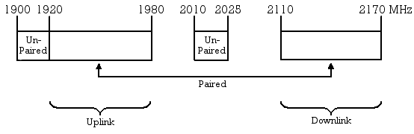
UMTS Frequency Spectrum
UMTS Band : 1900-2025 MHz and 2110-2200 MHz for 3G transmission.
Terrestrial UMTS (UTRAN) : 1900-1980 MHz, 2010-2025 MHz, and 2110-2170 MHz bands

Slide 20
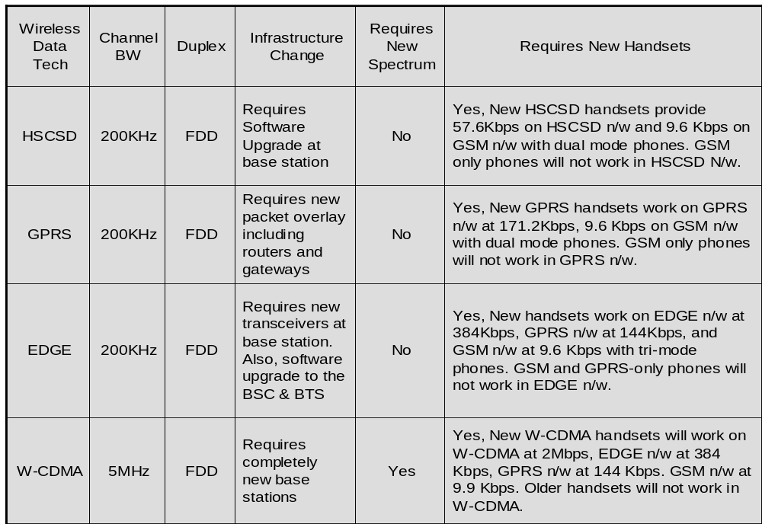
IMPACT ON EXISTING NETWORK

Slide 21
WCDMA – 25 device suppliers
Amoi
BenQ
Fujitsu
Hisense
HTC
Huawei
LG
Mitsubishi
Motorola
NEC
Nokia
Novatel Wireless
NTT DoCoMo
(Raku Raku)
Panasonic
Pantech
Samsung
Sanyo
Seiko
Sharp
Siemens
Sierra Wireless
Sony Ericsson
Toshiba
Vodafone
(Option Wireless PC card)
ZTE

Slide 22
Combined WCDMA-EDGE networks
At least 40 operators are delivering 3G services on combined
WCDMA-EDGE networks. WCDMA and EDGE are comple-mentary technologies ensuring lower capital cost, optimum flexibility and efficiencies
AIS, Thailand
Ålands Mobiltelefon, Finland
Batelco, Bahrain
Cellcom, Israel
Cingular Wireless, USA
CSL, Hong Kong
Dialog GSM, Sri Lanka
Elisa, Finland
EMT, Estonia
Eurotel Praha, Czech
Eurotel Bratislava, Slovak
GPTC, Libya
Maxis, Malaysia
Mobilkom Austria
Mobitel, Bulgaria
Mobily, Saudia Arabia
MTC Vodafone, Bahrain
MTN, South Africa
Netcom, Norway
Orange, France
Orange, Romania
Orange Slovensko, Slovak
Oskar Mobile, Czech
Pannon GSM, Hungary
Polkomtel, Poland
Rogers Wireless - Fido, Canada
Si. Mobil – Vodafone, Slovenia
Swisscom, Switzerland
Telenor, Norway
T-Mobile, Croatia
T-Mobile, Czech
T-Mobile, Hungary
T-Mobile, USA
Telfort, Netherlands
TeliaSonera, Denmark
TeliaSonera, Finland
TeliaSonera, Sweden
TIM Hellas, Greece
TIM, Italy
VIP Net, Croatia

Slide 23
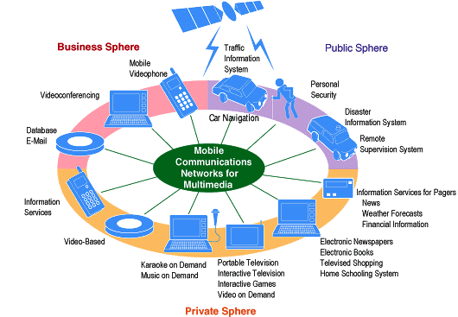
W-CDMA makes possible a world of mobile multimedia

Slide 24
CDMA2000 evolution to 3G
IS-95B
Uses multiple code channels
Data rates up to 64kbps
Many operators gone direct to 1xRTT
CDMA2000 1xEV-DO: Evolved Data Optimised
Third phase in CDMA2000 evolution
Standardised version of Qualcomm High Data Rate (HDR)
Adds TDMA components beneath code components
Good for highly asymmetric high speed data apps
Speeds to 2Mbps +, classed as a “3G” system
Use new or existing spectrum
IS-95B
CDMA
IS-95A
1xEV-DO
1xEV-DV
CDMA2000
3xRTT
IS-95A
14.4 kbps
Core network re-used in
CDMA2000
1xRTT
CDMA2000 1x Evolved DV
Fourth phase in CDMA2000 evolution
Still under development
Speeds to 5Mbps+ (more than 3xRTT!)
Possible end game.
CDMA2000 1xRTT: single carrier RTT
First phase in CDMA2000 evolution
Easy co-existence with IS-95A air interface
Release 0 - max 144 kbps
Release A – max 384 kbps
Same core network as IS-95

Slide 25
IS-95A
CDMA was commercially introduced in 1995 with IS-95A or cdmaOne. IS-95A is the CDMA-based second generation (2G) standard for mobile communication. The following
are the key aspects of this standard:
Support for data rates of upto 14.4 kbps
IS-95A has been used exclusively for circuit-switched voice
Convolutional Channel coding used
Modulation technique used is BPSK

Slide 26
IS-95B
IS-95B or cdmaOne is the evolved version of IS-95A and is designated as 2.5G. IS-95B maintains the Physical Layer of IS-95A, but due to an enhanced MAC layer, is capable of providing for higher speed data services. The following are the key aspects of the standard:
Theoretical data rates of upto 115 kbps, with generally experienced rates of 64 kbps
Additional Walsh codes and PN sequence masks, which enable a mobile user to be assigned up to eight forward or reverse code channels simultaneously, thus enabling a higher data rate
Code channels, which are transmitted at full data rates during a data burst
Convolutional Channel coding
Binary Phase Shift Keying (BPSK) as the Modulation technique used

Slide 27
CDMA 2000 1X
Supports theoretical data rates of upto 307 kbps, with generally experienced rates of 144 kbps
The newly introduced Q-PCH of CDMA 2000 enables the mobile to be informed about when it needs to monitor F-CCCH and the Paging Channel, thus improving on the battery life
Introduction of Radio Configurations – Transmission formats characterized by physical layer parameters such as data rates, modulation characteristics, and spreading rate. RCs help in providing for additional data rates.
Quality and Erasure indicator bits (QIB and EIB) on the reverse power control sub channel. These help in indicating to the BS about bad frames or lost frames received at the mobile station, so that they can be retransmitted
Code channels are transmitted at full data rates during a data burst
Convolutional and Turbo coding techniques used
Modulation technique used is QPSK

Slide 28
CDMA 2000 3X
Offering data speeds up to 2 Mbps
Using three standard 1.25 MHz channels within a 5 MHz band
Leveraging deployment experiences, and manufacturers’ learning curves of today’s widely adopted, commercially available CDMA systems
Using Convolutional and Turbo coding techniques
Using QPSK as the Modulation technique

Slide 29
1X EV-DO
Supporting data rates of up to 2.4 Mbps
Having no backward-compatibility with CDMA 2000
Including two inter-operable modes: an integrated 1x mode optimized for voice and medium data speeds, and a 1xEV mode optimized for non real-time high capacity/high speed data and Internet access
Providing Adaptive Rate Operation with respect to channel conditions
Providing Adaptive modulation and coding
Providing Macro diversity via radio selection
Providing an always-on operation of 1xEV-DO terminals in the active state
Using a multi-level modulation format (QPSK, 8-PSK, 16-QAM)

Slide 30
1xEV-DV
Backward compatible with CDMA 2000.
EV-DV can be easily extended to operate in 3x mode under the framework of current system.
Forward peak data rate : 3.072 Mbps.
Reverse peak data rate: 451.2 kbps.
Addition of three new channels to f/w link and reverse link for packet data operation and its support.
Adaptive modulation and coding : QPSK, 8- PSK, 16-QAM
Variable frame duration
Mobile station can select one of N base stations.
DTX transmission supported for saving battery life.

Slide 31
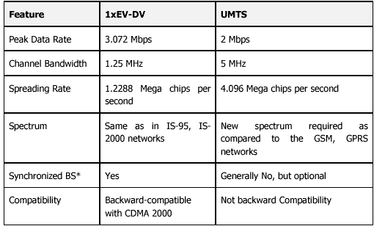
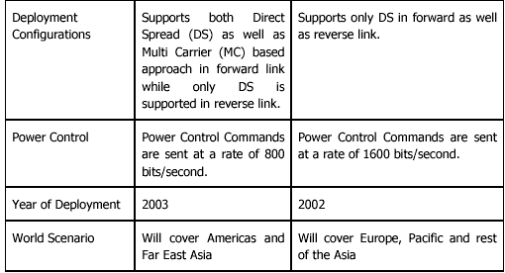
1xEV-DV and UMTS Comparison

Slide 32
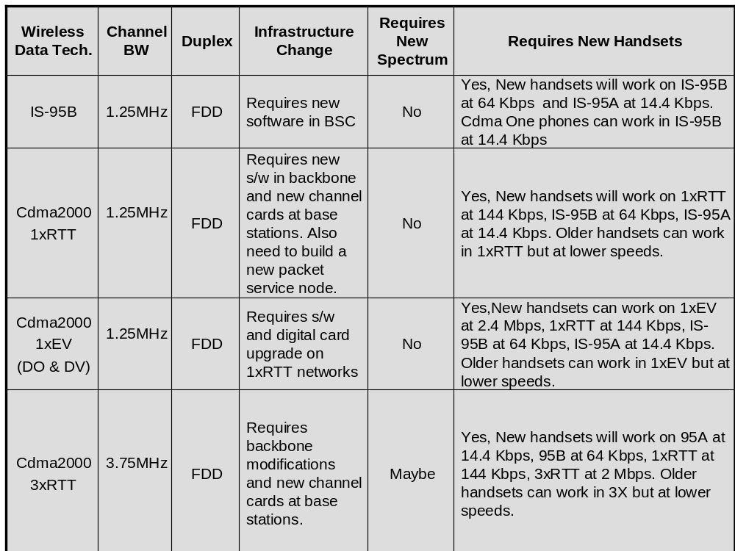
IMPACT ON EXISTING NETWORK

Slide 33
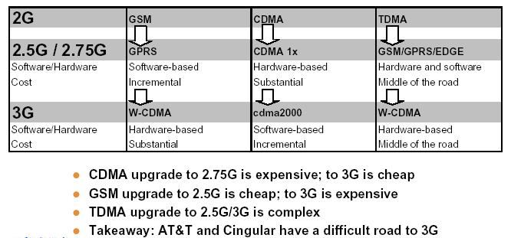

Slide 34
CDMA2000 1X and CDMA 1X EVDO Vendors
Terminal Vendors
Audiovox
Ericsson
Hyundai CURITEL
Kyocera
LG Electronics
Motorola
Nokia
Samsung
Sanyo
SK TeleTech
Wireless Modem
AirPrime
AnyDATA
GTRAN
Novatel Wireless
Sierra Wireless

Slide 35
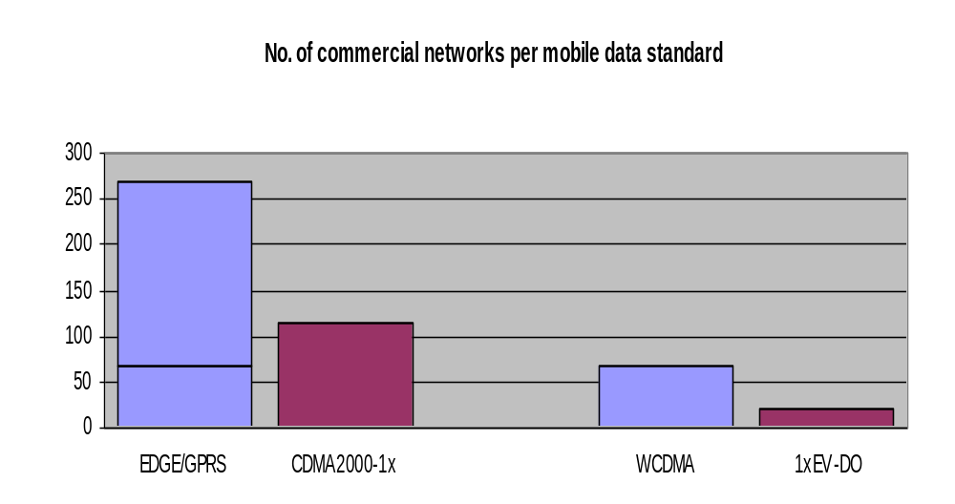
Adoption of different mobile standards
First steps to 3G
  270 commercial GPRS networks
  141 networks deploying GPRS/EDGE
  84 commercial EDGE networks
  (source: GSA, May 16, 2005)
  121 commercial Cdma2000 1x networks
  (source: CDG, May 13, 2005)
3G
  WCDMA: 134 licenses awarded
  71 commercial WCDMA networks
  (source: GSAMay 12, 2005)
  22 commercial CDMA 1x EV-DO networks
  (source: CDG, May 13, 2005)
Evolved 3G
  HSDPA: all WCDMA operators expected to upgrade to HSDPA (SW upgrade to BTS)
  CDMA 1x EV-DV: limited industry support

Slide 36
3G Network Vendors: Groups and JV
1. ALCATEL + FUJITSU (Alcatel hold 66 percent of the shares of the Evolium SAS, and Fujitsu holds the rest)
2. SIEMENS + NEC (Mobisphere Ltd.,) + CASIO / TOSHIBA
3. MOTOROLA + CISCO + FIJITSU + PIONEER + ALCATEL (Alcatel RNC, MOTOROLA Node B)
4. SAGEM + FUJITSU (Handset)
6. NOKIA + CISCO (IP Core network),
7. NOKIA + Interdigital (technology development relationship)
8. NORTEL + Matsushita/Panasonic + SAMSUNG
9. LUCENT (alone)
10.ERICSSON (alone)
11.CISCO+KPMG Cisco routeurs, KPMG consulting

Slide 37
3.5G
3.5G or HSDPA (High Speed Downlink Packet Access) is an enhanced version and the next intermediate generation of 3G UMTS. It comprises the technologies that improve the Air Interface and increase the spectral efficiency, to support data rates of the order of 30 Mbps. 3.5G introduces many new features that will enhance the UMTS technology in future. 1xEV-DV already supports most of the features that will be provided in 3.5G. These include:
Adaptive Modulation and Coding
Fast Scheduling
Backward compatibility with 3G
Enhanced Air interface

Slide 38
4G: Anytime, Anywhere Connection
Also known as ‘Mobile Broadband everywhere’
‘MAGIC’
  Mobile Multimedia Communication
  Anywhere, Anytime with Anyone
  Global Mobility Support
  Integrated Wireless Solution
  Customized Personal Service
According to 4G Mobile Forum, by 2008 over $400 billion would be invested in 4G mobile projects.
In India, communication Minister Mr. Dayanidhi Maran, has announced a national centre of excellence to work in 4G arena.

Slide 39
4G: Data rate Facts
Transmission at 20 Mbps
2000 times faster than mobile data rates
10 times faster than top transmission rates planned in final build out of 3G broadband mobile
10-20 times faster than standard ADSL services.
Companies developing 4G technology
  Cellular phone companies: Alcatel, Nortel, Motorola,
  IT Companies: Hughes,HP,LG Electronics

Slide 40
Thanks

